Slide 1
Deep Dive into Cloud Security: Threats, Breaches & Shared Responsibility
Syed Aquib
Security Fundamentals For Cloud

Slide 2
CC ZG504, Cloud Security Foundations Lecture No.1

Slide 3
Agenda
Part 1: Cloud Computing Foundations (30 minutes)
Cloud Computing Basics
Why Cloud Security
Shared Responsibility in Detail
Part 2: The Shared Security Model: Clarity and Accountability (30 minutes)
Defining Shared Responsibility
Compliance and Legal Considerations
Part 3: Deep Dive into Cloud Threats (45 minutes)
Threats and Vulnerabilities in the Cloud
Case Studies: Lessons Learned
DoS/DDoS Attacks in the Cloud
Q&A and Discussion (15 minutes)

Slide 4
Cloud Computing 101:
A Quick Refresher
"The cloud is about how you do computing, not where you do computing." – Paul Maritz (VMware)
Service Models:
Infrastructure as a Service (IaaS): Virtualized computing resources (servers, storage, networks).
Platform as a Service (PaaS): A platform for developing, running, and managing applications.
Software as a Service (SaaS): Applications hosted and delivered over the internet.
Deployment Models:
Public Cloud: Shared resources accessible over the public internet.
Private Cloud: Dedicated resources for a single organization.
Hybrid Cloud: Combination of public and private cloud environments.

Slide 5

What is Cloud Computing?

Slide 6
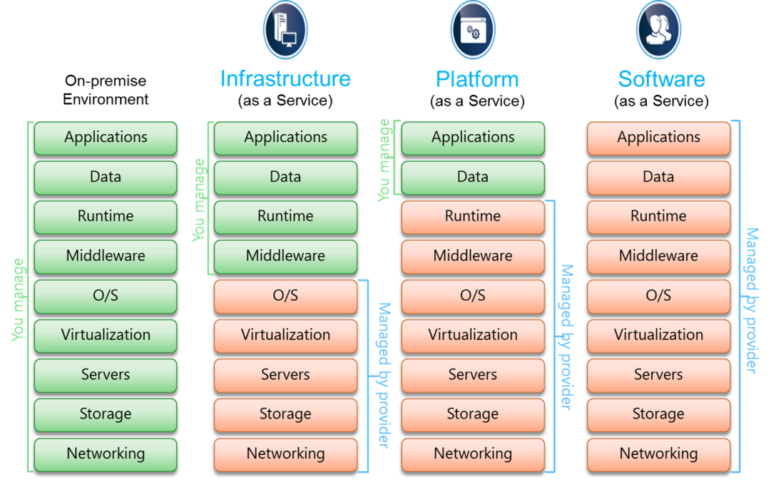
Service Models

Slide 7
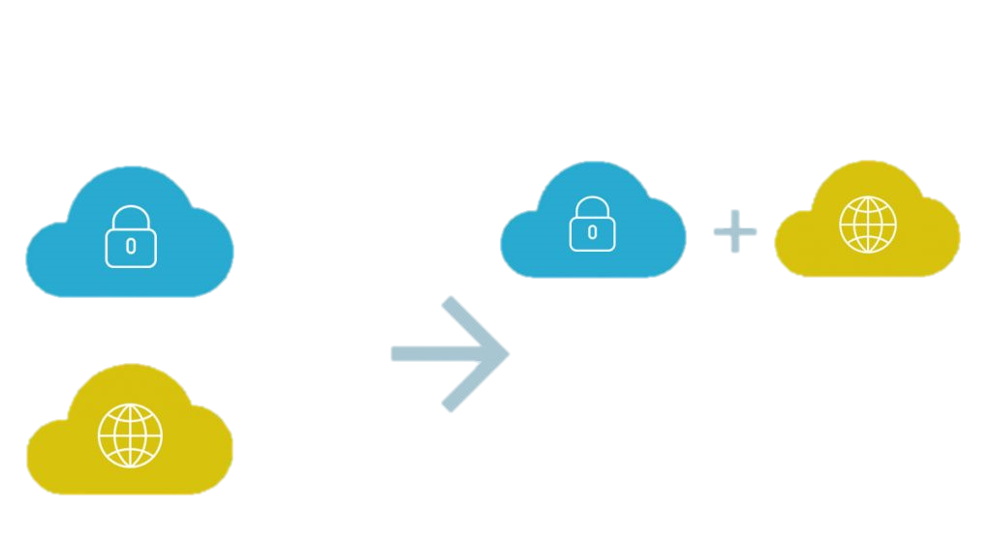
Deployment Models
Private Cloud
Fully Customizable
Robust Management
Secure by Design
Hybrid Clouds = Better Outcomes
Scalability
Flexibility
Security
Cost Efficiency Hybrid Cloud – Leveraging both Public & Private Cloud
Public Cloud
Low Entry Cost
Pay As You Go
High Elastic

Slide 8


Deployment Models
Private Cloud:
Services are used exclusively by a single organization.
Managed either internally or by a third-party, but on a private network.
Ideal for: Large enterprises with specific data security needs.
Public Cloud:
Services are offered over the internet by third-party providers.
Examples: Google Cloud, Amazon Web Services (AWS), Microsoft Azure.
Ideal for: General public, startups, and businesses needing cost-effective solutions.
This Photo by Unknown Author is licensed under CC BY-SA
This Photo by Unknown Author is licensed under CC BY-SA-NC

Slide 9
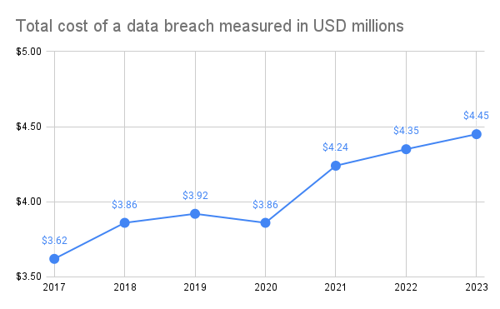
The Stakes are High:
Why Cloud Security is Critical
The Global Average Cost of a Data Breach Increased by 2.3%.
In 2023, the cost of a data breach rose to USD 4.45 million, over $100,000 more than the previous year. As shown below, the average data breach cost has consistently increased every year since 2017.
Data Breaches: Loss of sensitive data (customer information, financial records, intellectual property).
Downtime: Disruption of business operations and loss of revenue.
Compliance Violations: Regulatory fines and legal liabilities.
Reputational Damage: Loss of customer trust and brand value.

Slide 10
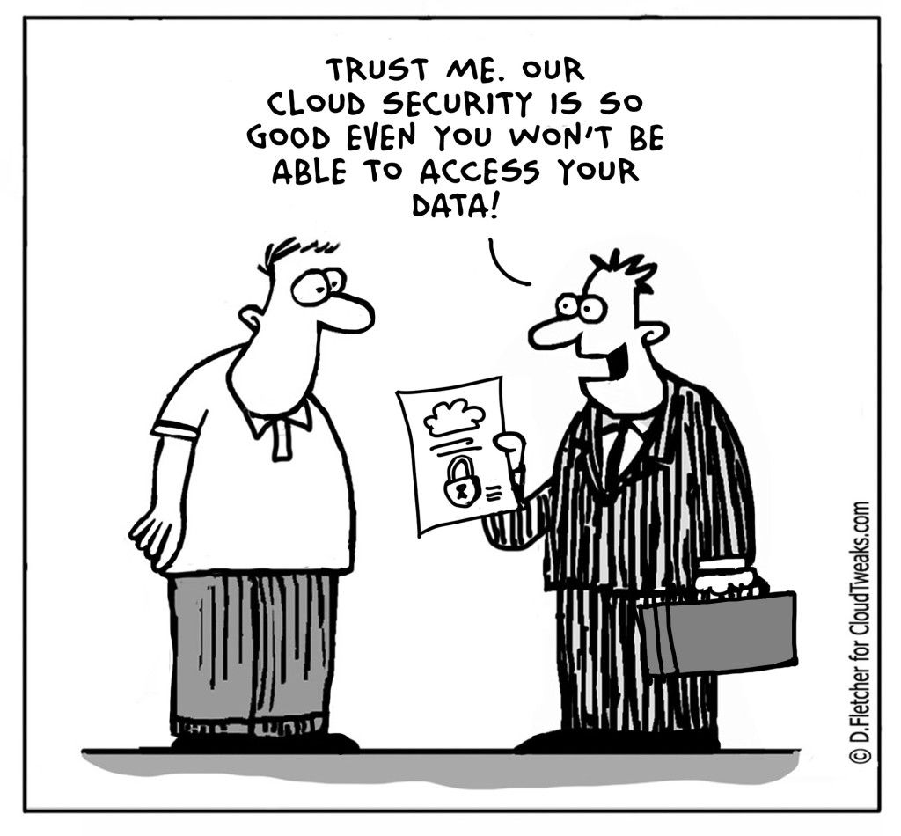
Cloud Security

Slide 11
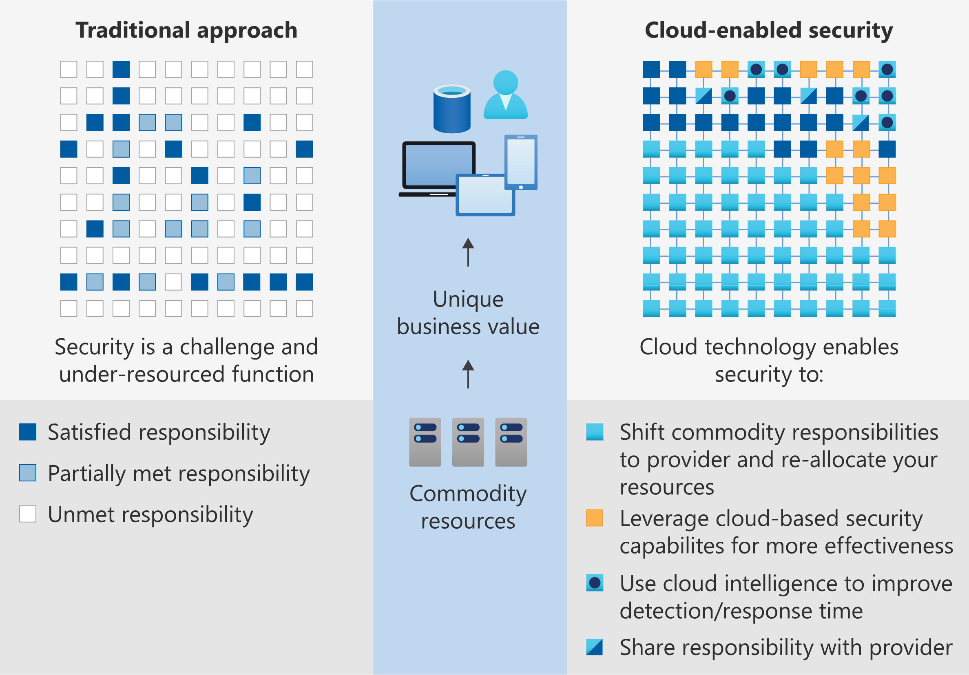
Who's Responsible for What?
Understanding the Shared Security Model
Cloud Provider: Security "of" the cloud (physical infrastructure, network, virtualization layer).
Customer: Security "in" the cloud (operating systems, applications, data).
IaaS: Customer has more responsibility (OS, applications, data).
PaaS: Shared responsibility (cloud provider manages OS and underlying infrastructure).
SaaS: Provider has more responsibility (application security, data).

Slide 12
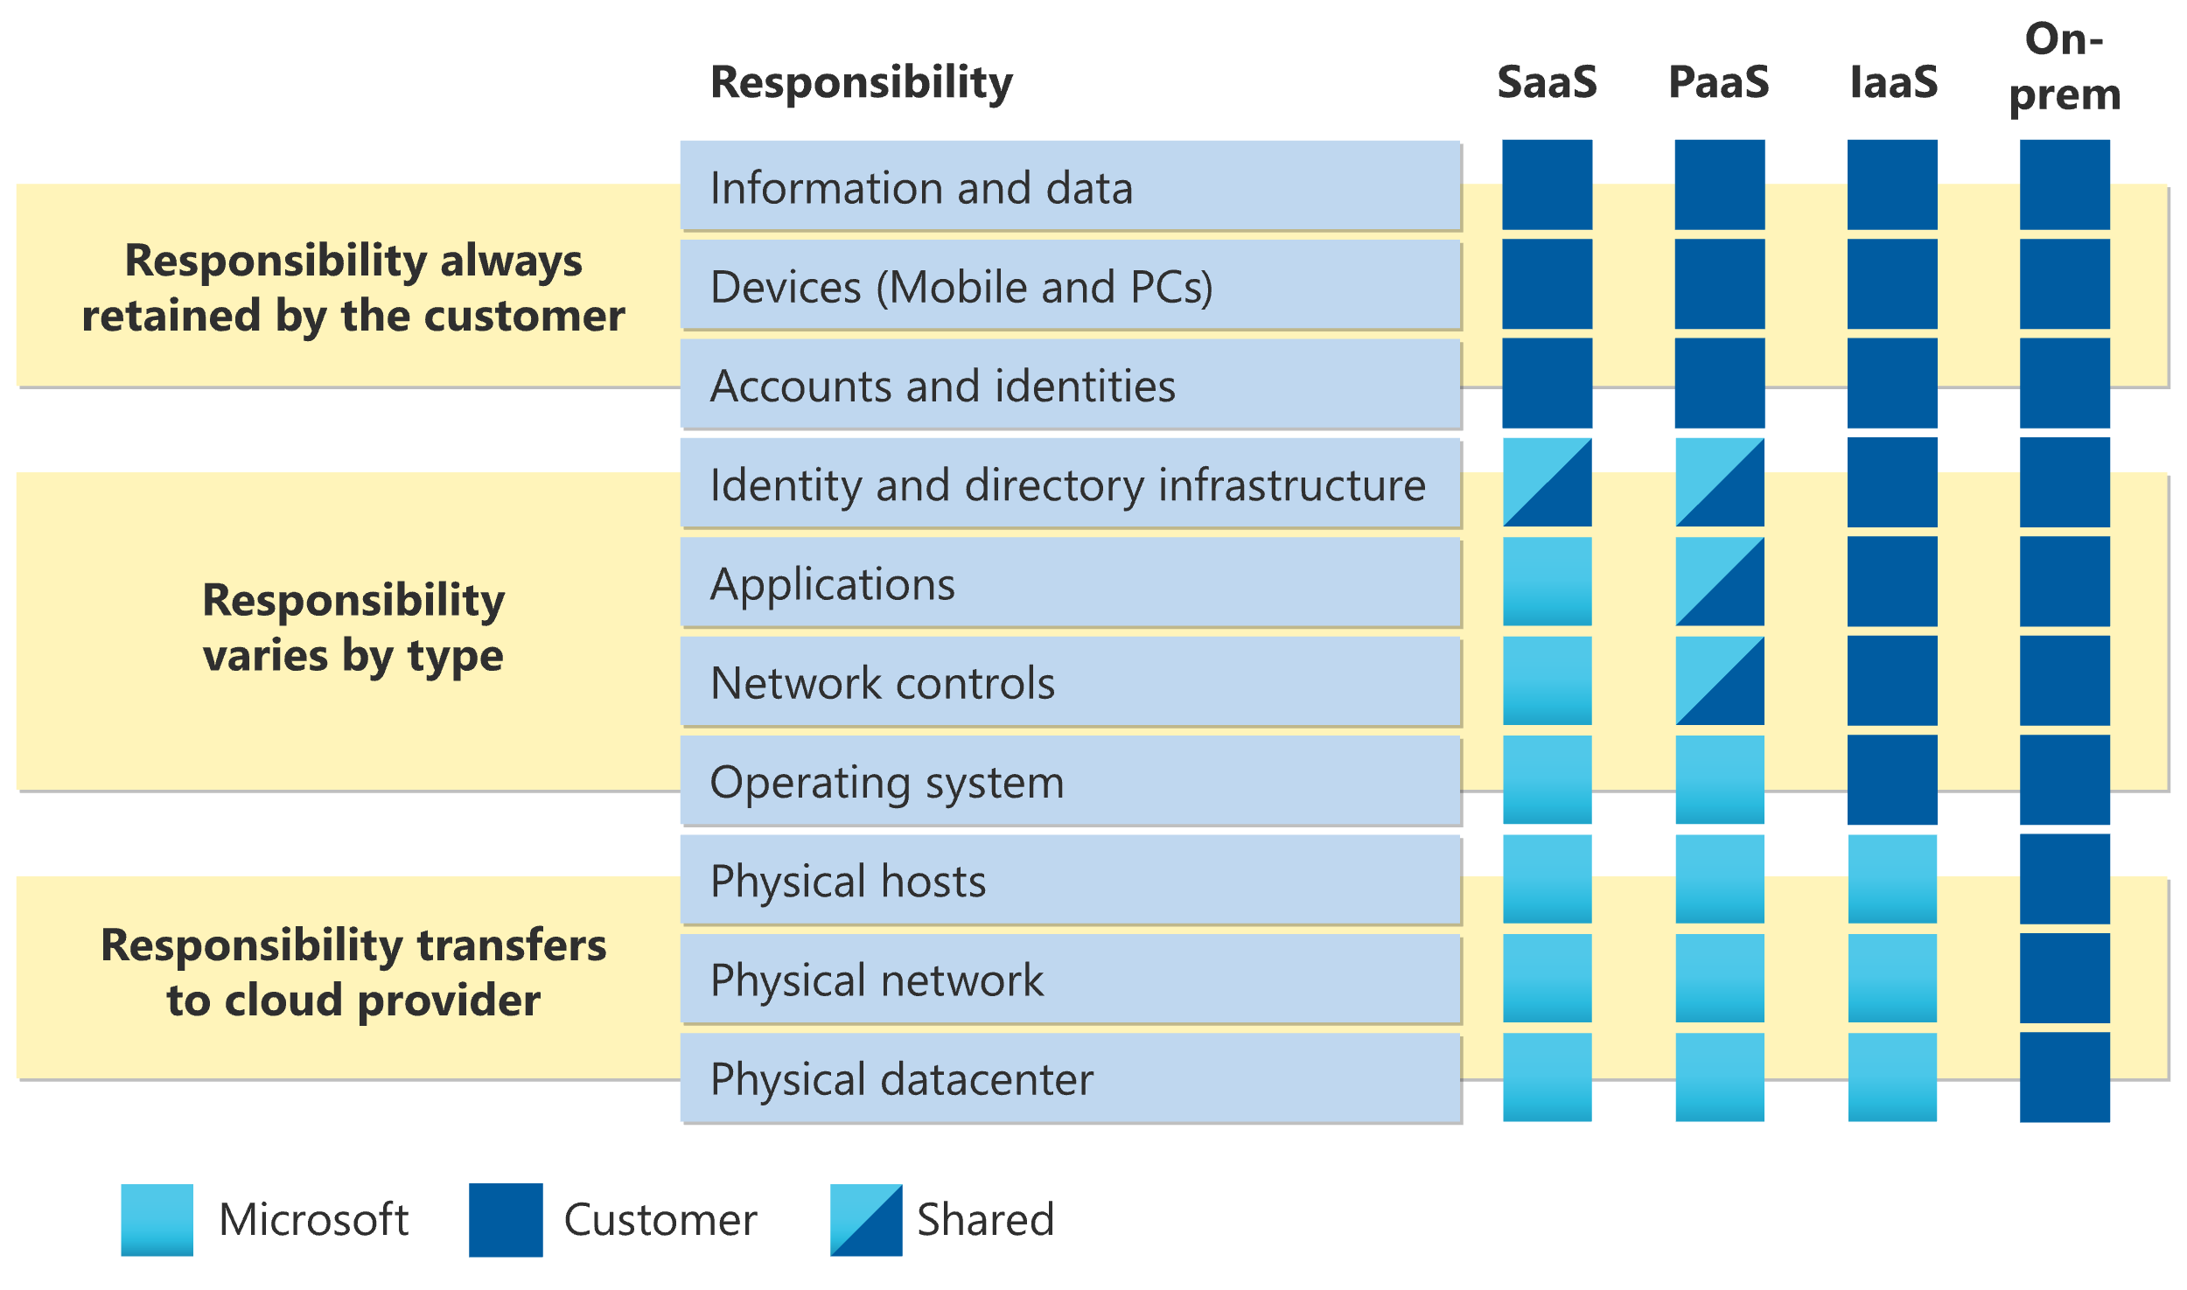
Demystifying the Shared Responsibility Model
Key Principle:
Security is a joint effort between the cloud provider and the customer.
Customer Responsibilities:
Data classification and encryption
Identity and access management (IAM)
Network security controls
Application security
Patch management

Slide 13
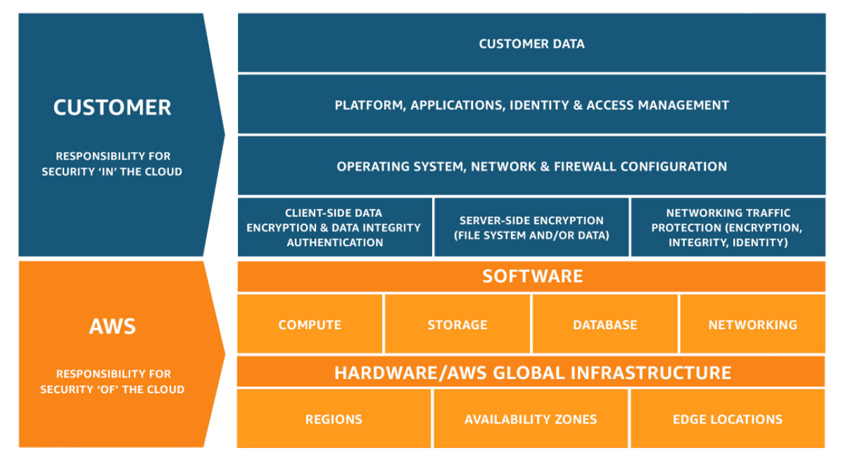
AWS - Shared Responsibility Model
Notes:
https://aws.amazon.com/compliance/shared-responsibility-model/

Slide 14
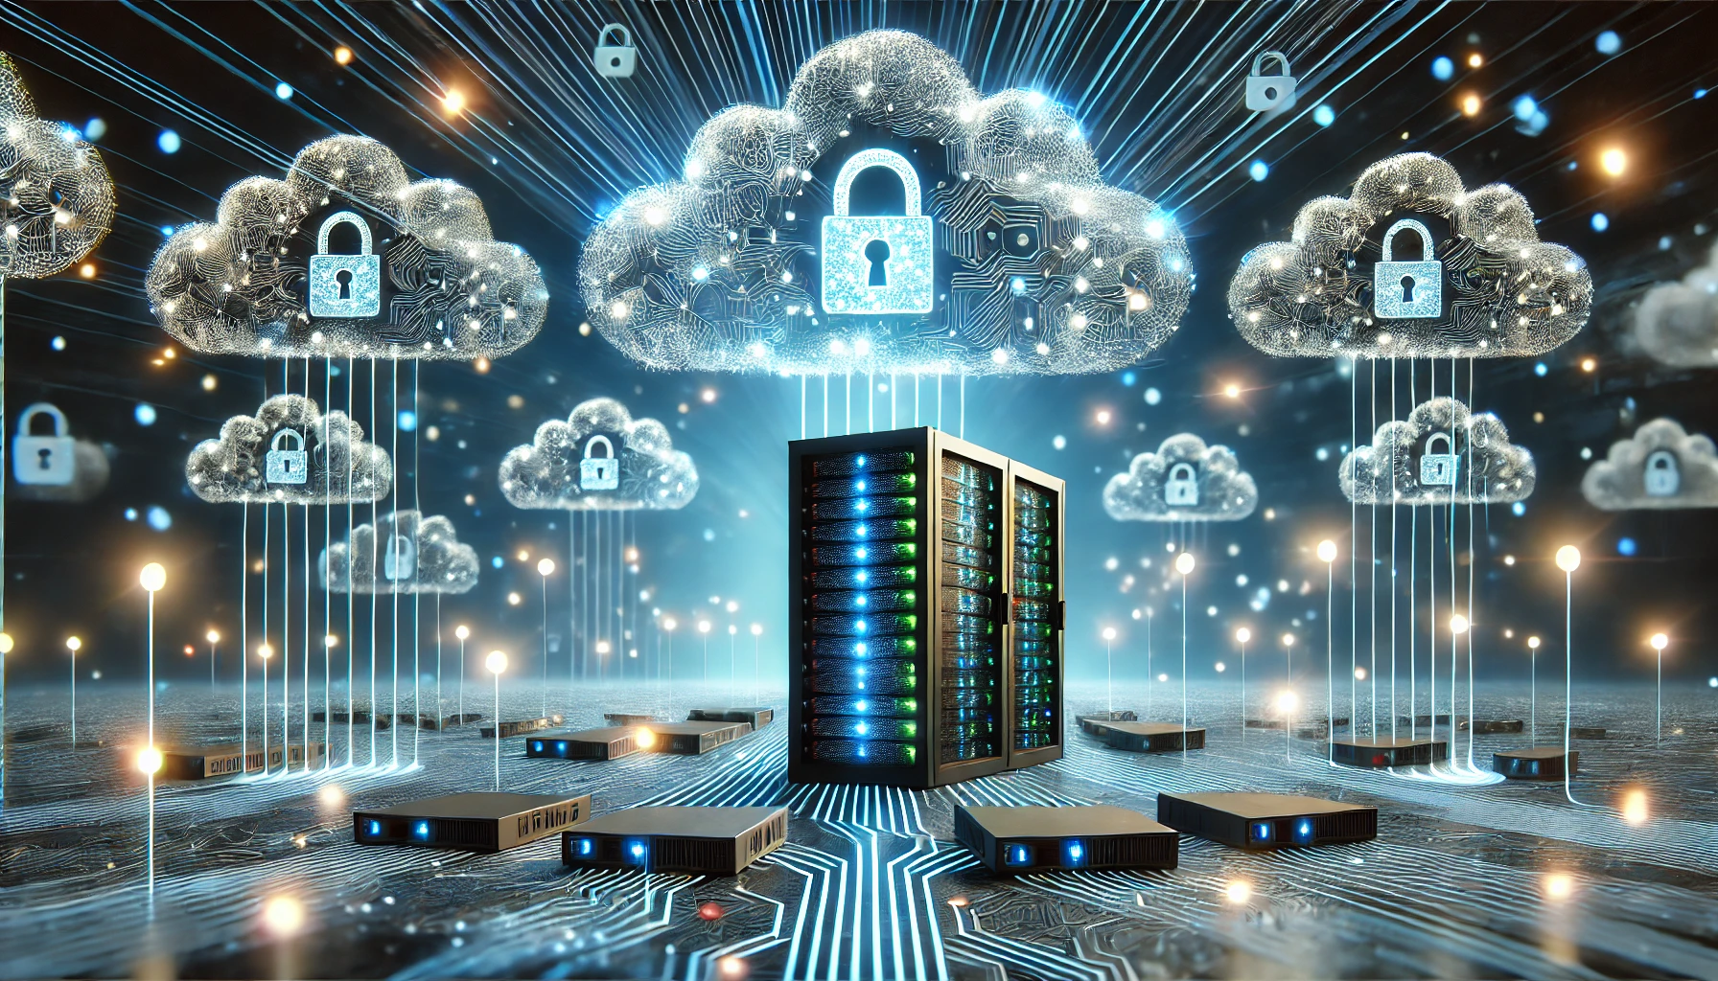
Navigating the Cloud Security Landscape: Threats, Vulnerabilities, and Best Practices

Slide 15
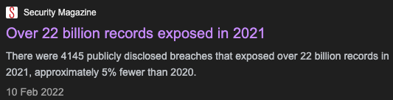
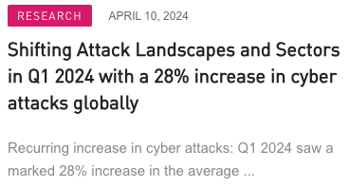
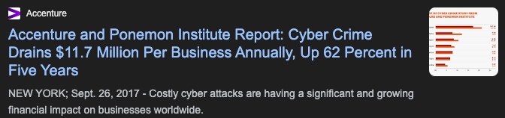
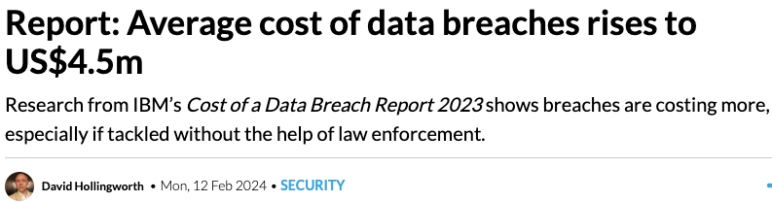

Slide 16
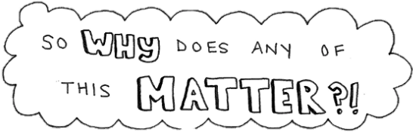
“No technology that’s connected to the internet is unhackable.” — Abhijit Naskar
A Cloud Security Alliance report revealed that 98% of organizations worldwide use cloud services. ^{Source: CSA}
95% of companies are concerned about cloud security. ^{Source: Fortinet}

Slide 17
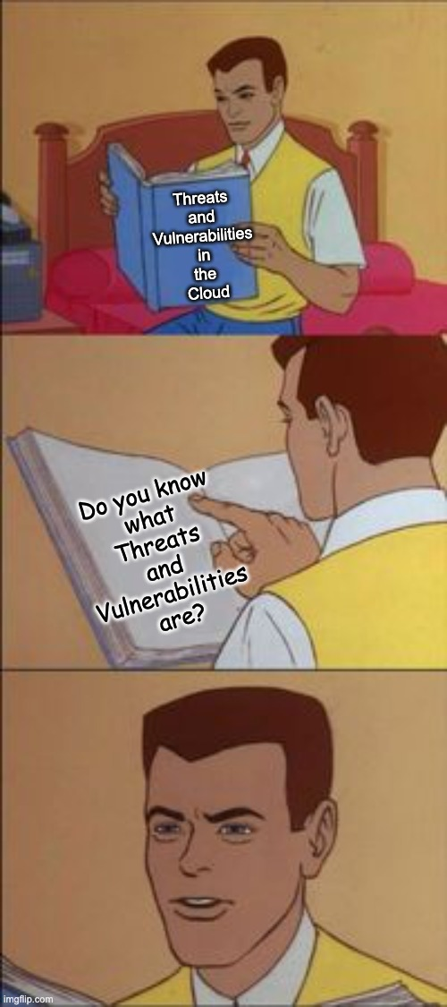



Cloud Threats and Vulnerabilities: The Basics
Threats: These are the bad guys trying to break in or cause trouble:
Data Breaches: Someone steals your private information, like credit card numbers.
Think of it like: A thief breaking into your house and stealing your jewelry.
Malware: Harmful software sneaks into your system and disrupts operations or steals data.
Think of it like: A virus infecting your computer and making it crash.
Ransomware: Hackers lock your files and demand payment to unlock them.
Think of it like: Kidnappers taking your stuff hostage and asking for a ransom.
Account Hijacking: Someone takes over your account and uses it without permission.
Think of it like: Someone stealing your car keys and driving off with your car.
Insider Threats: Someone working for your company does something bad to your system.
Think of it like: A dishonest employee stealing money from the cash register.

Slide 18

Cloud Threats and Vulnerabilities: The Basics
Vulnerabilities: These are weaknesses in the castle walls that the bad guys can exploit:
Software Vulnerabilities: Bugs or glitches in the programs you use in the cloud.
Think of it like: Cracks in a castle wall that enemies can squeeze through.
Hardware Vulnerabilities: Weaknesses in the physical equipment running the cloud.
Think of it like: A weak spot in the castle's foundation that could collapse.
Configuration Vulnerabilities: Mistakes in setting up the cloud that leave it open to attack.
Think of it like: Leaving a castle gate unlocked, making it easy for invaders to enter.
Human Vulnerabilities: Employees might accidentally or intentionally create weaknesses.
Think of it like: A guard falling asleep on duty, allowing enemies to sneak past.

Slide 19
The Enemy at the Gates: Cloud Threats and Vulnerabilities
66% of organizations experienced a cloud security incident in the past year ^{Check Point Research, 2023}
Data Breaches: Unauthorized access to sensitive data.
Malware: Malicious software designed to disrupt operations or steal data.
Ransomware: Encryption of data with demands for payment.
Account Hijacking: Unauthorized access to user accounts.
Misconfigurations: Errors in cloud setup that expose vulnerabilities.
Insider Threats: Malicious actions by employees or contractors.

Slide 20
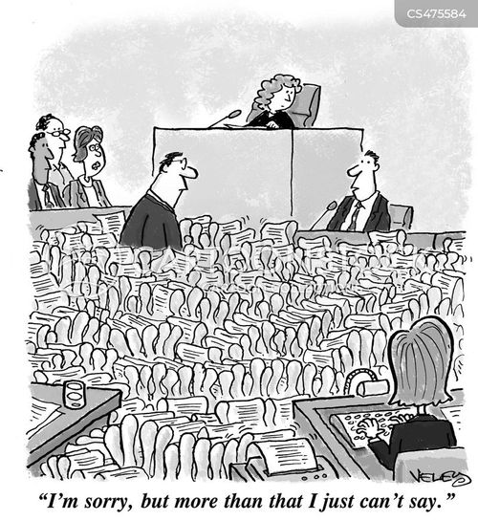
Navigating the Legal Landscape of Cloud Security
The cloud isn't just tech; it's got rules too. Like a kingdom, it's got laws to protect your data.
Data Protection Rules (GDPR, CCPA, etc.): These are like the kingdom's laws for protecting people's info. Break them, you pay a fine.
Industry Rules (PCI DSS, etc.): Some industries have extra rules, like handling credit cards. It's like a blacksmith guild having special safety rules for hot metal.
Contractual Agreements - Service Level Agreements (SLAs), Data Processing Agreements (DPAs): Your deal with the cloud company is like a treaty. It says what they do and what you do. Break it, and there's trouble.
Where's Your Data? - Jurisdiction and Data Sovereignty: This is like knowing your kingdom's borders. Some places have rules about where data can be. Break them, and it's like trespassing.

Slide 21
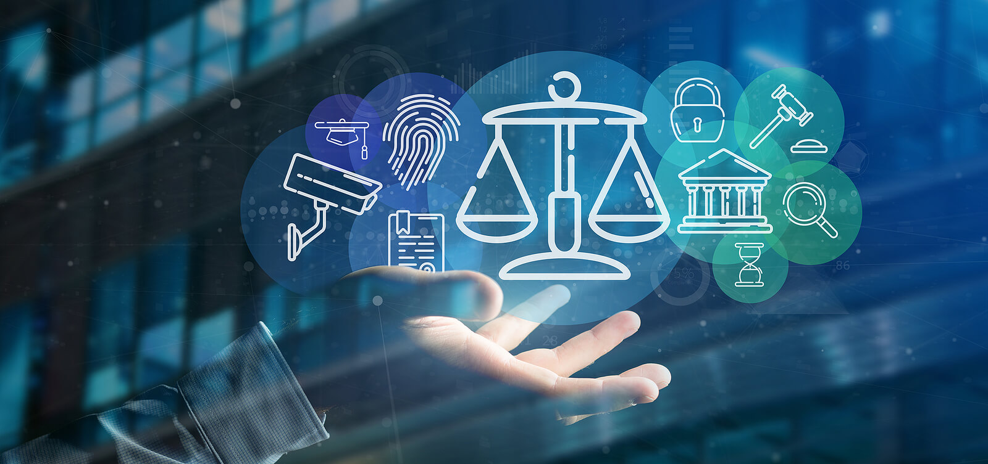
Navigating the Legal Landscape of Cloud Security
Data Protection Regulations: GDPR (EU), CCPA (California), HIPAA (US healthcare) mandate strict data privacy and security controls. Your cloud provider's location and practices must align with these regulations to avoid legal risk.
Industry-Specific Standards: PCI DSS (Payment Card Industry) requires robust security measures for handling credit card data. Choosing a compliant provider is essential to prevent breaches and financial penalties.
Contractual Agreements: SLAs (Service Level Agreements) define the provider's performance guarantees, while DPAs (Data Processing Agreements) clarify roles and responsibilities in protecting data under GDPR.
Jurisdiction and Data Sovereignty: The location of your data's storage and processing can have significant legal implications. Be mindful of data sovereignty laws and choose providers in jurisdictions with favorable data protection frameworks.
Key Takeaways:
Thoroughly vet cloud providers for compliance with relevant regulations and standards.
Scrutinize contracts (SLAs and DPAs) to protect your interests.
Consult legal experts for guidance on navigating complex legal requirements.

Slide 22
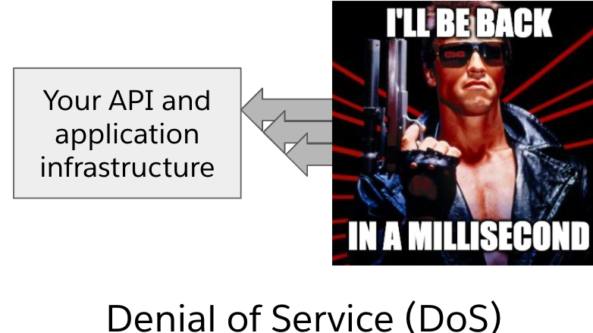
DoS/DDoS Attacks in the Cloud
Imagine this:
You're Skynet: Your website or online service is the powerful, intelligent core of your operation, like Skynet in the Terminator universe.
The Attackers are T-800 Terminators: They're relentless, single-minded machines programmed with one goal: to overwhelm your defenses and shut you down.
The Result: Your website or service slows to a crawl, crashes, or becomes completely inaccessible. It's like Skynet being temporarily disabled, unable to coordinate its forces or carry out its mission.
Why the "I'll Be Back" reference? Denial of Service attacks are often persistent. The attackers might retreat temporarily, but they'll keep coming back, just like the Terminator's relentless pursuit.
Types of Attacks:
DoS (Single Attacker): It's like one lone T-800 Terminator trying to break through your defenses. Difficult, but manageable.
DDoS (Multiple Attackers): This is the full-on Terminator assault! A legion of machines attacking from all sides, making it much harder to defend against.
How to Protect Yourself (aka "How to Be a John Connor Against the Terminators"):

Slide 23
Learning from the Past:
Capital One Data Breach: A Case Study
Overview: In 2019, Capital One, a leading U.S. bank and early adopter of cloud computing, experienced a significant data breach affecting 106 million customers.
Attack Details: An attacker exploited a misconfigured web application firewall (WAF) and a server-side request forgery (SSRF) vulnerability to gain unauthorized access to sensitive customer data stored on the company's cloud servers.
Compliance and Regulatory Landscape: Despite adhering to industry regulations and frameworks like the NIST Cybersecurity Framework, the breach occurred due to misconfigured security controls and a failure to follow the principle of least privilege.
Key Takeaways:Compliance is necessary but not sufficient for preventing data breaches.
Proper implementation, maintenance, and continuous monitoring of security controls are crucial.
A strong security culture and skilled personnel are essential.
Cloud environments require specific security measures.
Lessons Learned: The Capital One incident highlights the importance of proactive risk management, continuous improvement in security practices, and the need for robust security measures in cloud environments. It serves as a reminder that even technologically advanced and compliant organizations can be vulnerable to cyberattacks.
Notes:
https://cams.mit.edu/wp-content/uploads/capitalonedatapaper.pdf

Slide 24
Learning from the Past:
Tesla Cryptojacking Incident: A Case Study
What:
Unauthorized use of Tesla's cloud resources to mine cryptocurrency.
How:
Hackers gained access through an unsecured Kubernetes console, then exploited vulnerabilities in the broader cloud environment.
Impact:
Potential exposure of sensitive test vehicle data. Tesla quickly addressed the issue, but the incident raises significant concerns about cloud security.
Takeaways:
Cryptojacking is a growing and sophisticated threat.
Cloud environments require robust security measures and vigilance.
Organizations must prioritize incident response and recovery plans.
Notes:
https://www.wired.com/story/cryptojacking-tesla-amazon-cloud/

Slide 25
Learning from the Past:
LockBit Ransomware Attack on Accenture: A Case Study
Overview:
In August 2021, Accenture, a consulting firm, was targeted by the LockBit ransomware gang. LockBit claims to have stolen data from Accenture and some of its clients, including compromising an airport's systems, but Accenture denies this.
Attack Details:
LockBit alleges they used stolen credentials to gain access, but Accenture refutes this. While LockBit claims to possess stolen data, there's no independent verification of this. The full extent of the breach remains unclear.
Compliance and Regulatory Landscape:
This attack underscores the growing threat of ransomware and the importance of robust cybersecurity measures. Companies must prioritize data protection and have incident response plans in place.
Key Takeaways:
Ransomware attacks are a significant threat to businesses.
Even large, established companies like Accenture can be targeted.
It's crucial to have a strong cybersecurity posture and incident response plan.
Lessons Learned:
Regularly assess and update your cybersecurity measures.
Conduct regular data backups and test their integrity.
Educate employees on cybersecurity best practices.
Have a comprehensive incident response plan to minimize damage and recovery time.
Notes:
https://www.crn.com/news/security/accenture-clients-breached-by-lockbit-ransomware-gang-report

Slide 26
Learning from the Past:
Home Depot: 56M Cards Impacted, Malware Contained
Overview: Home Depot experienced a data breach where hackers stole an estimated 56 million debit and credit card numbers between April and September 2014. The company believes the hackers installed custom-built malware on its self-checkout systems.
Attack Details: Hackers installed malware on Home Depot's self-checkout systems that stole debit and credit card information from customers who used the systems between April and September of 2014.
Compliance and Regulatory Landscape: This is the largest retail card breach on record. The breach is believed to have lasted from April to September 2014. Home Depot has since implemented enhanced encryption measures to protect customer data.
Key Takeaways: Home Depot experienced a data breach where hackers stole an estimated 56 million debit and credit card numbers. The company believes the hackers installed custom-built malware on its self-checkout systems. This is the largest retail card breach on record. Home Depot has since implemented enhanced encryption measures to protect customer data.
Lessons Learned: Companies should take steps to protect themselves from data breaches by implementing security measures such as encryption. Customers should be vigilant about monitoring their credit card statements for fraudulent activity.
Notes:
https://krebsonsecurity.com/2014/09/home-depot-56m-cards-impacted-malware-contained/

Slide 27
Group Activity – 5 mins Investigating Insider Threats: Your Turn
Find a Case Study: Research and select a real-world case study about an insider threat.
Analyze and Summarize: Use the following format to present your findings:
What Happened: A concise description of the events.
The How: Explain how the insider was able to carry out the breach.
The Significance: Discuss the impact of the incident on the organization and/or industry.
Key Takeaways: What lessons can be learned to prevent similar incidents in the future?
Be Prepared to Share: We'll have a class discussion to compare and contrast our case studies.

Slide 28
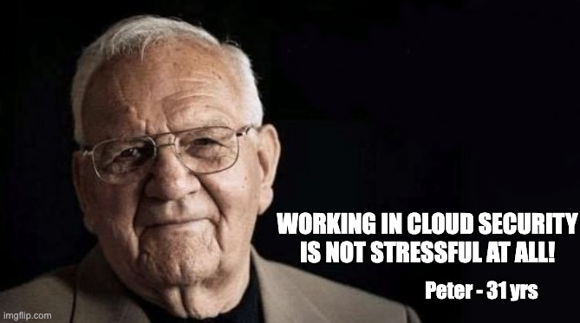
Is Peter telling the truth?

Slide 29

Thank you

